Slide 1

Huffman Codes
CLRS Chapter 16.3

Slide 2
What Are Huffman Codes?
A form of compression – takes data and makes it smaller.
A different way of encoding the alphabet:
ASCII is fixed length: if you have an alphabet of 256 characters, you can represent each character in 8 bits:
000110001100101100101000000001111101110010011001
So, a stream of 100 characters will take 800 bits. You will read the stream in 8-bit chunks, and translate each chunk into a character.
Can we represent the 100 characters more succinctly?

Slide 3
A Bit of Background on Compression
Big data → compression needed
Compression is ubiquitous. But not all compression is the same:
Lossy compression (finer details of data forever lost: mp3, jpeg, etc. What we use for A/V)
Lossless compression: you can get your entire data back. (all text compression). Zip, LZ variants, GIF.
We are interested in Lossless Compression

Slide 4
Idea Behind Huffman Coding
Languages are not composed of random strings: letter frequencies show great variety.
Consider the following language with 8 letters and their frequencies: A: 80%, B: 10%, C:4%, D:2%, E, F, G, H: 1% each.
300 bits needed to encode100 characters, 3 bits neded per character, if we encode each character in fixed length.
Instead, use a code for A that uses 1 bit, B 2 bits, C 3, D 4,
E, F, G, H 6 bits each. Total length for 100 characters is only 144 bits!

Slide 5
What Does Such a Code Look Like?
A: 0
B: 10
C: 110
D: 1110 What is special about this code?
E: 111100 How do we recognize character boundaries?
F: 111101
G: 111110
H: 111111

Slide 6
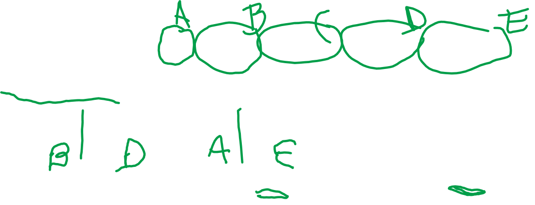
Prefix Code:
The code for a letter is never the prefix of another letter:
Bad: codes 00, 001, 0011, 0010, 10010
0010010: where are character boundaries?
001 0010 or 00 10010?
The problem is that 00 is a prefix of 001!
In a prefix code, this ambiguity never arises: when you see a match, that’s it…

Slide 7
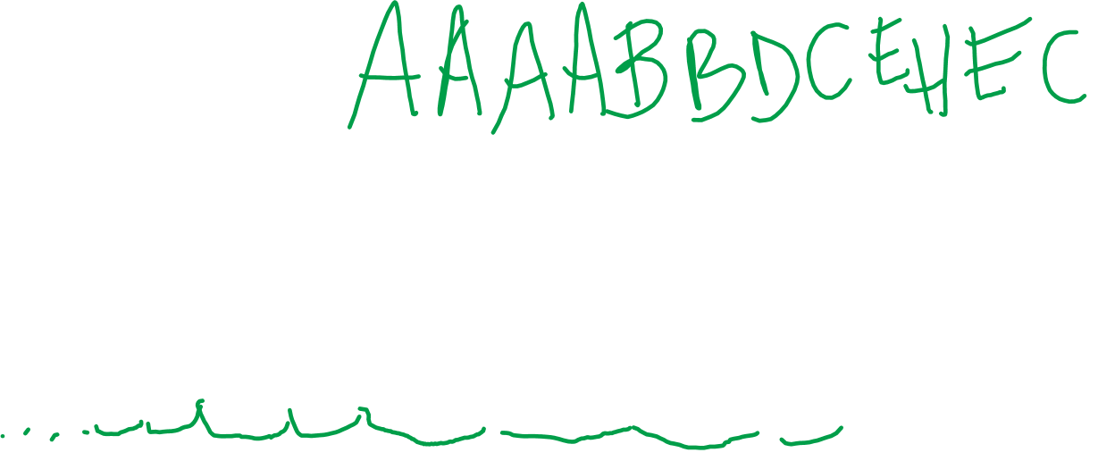
Translating Prefix Code (uncompressing)
A: 0
B: 10
C: 110
D: 1110
E: 111100
F: 111101
G: 111110
H: 111111
000010101110110111100111111111100110: AAAABBDCEHEC
This is the only translation. No ambiguity.

Slide 8
Representing a Prefix Code
We will represent the code as a full binary tree:
Each node has 0 or 2 children
Left edge down is marked 0, right 1
Alphabet symbols will be at the leaves
The code for an alphabet symbol is obtained by reading the labels from the root down to that leaf
In order to decode, one starts from the root down, once at a leaf, output label of that leaf.
Example on next slide.

Slide 9
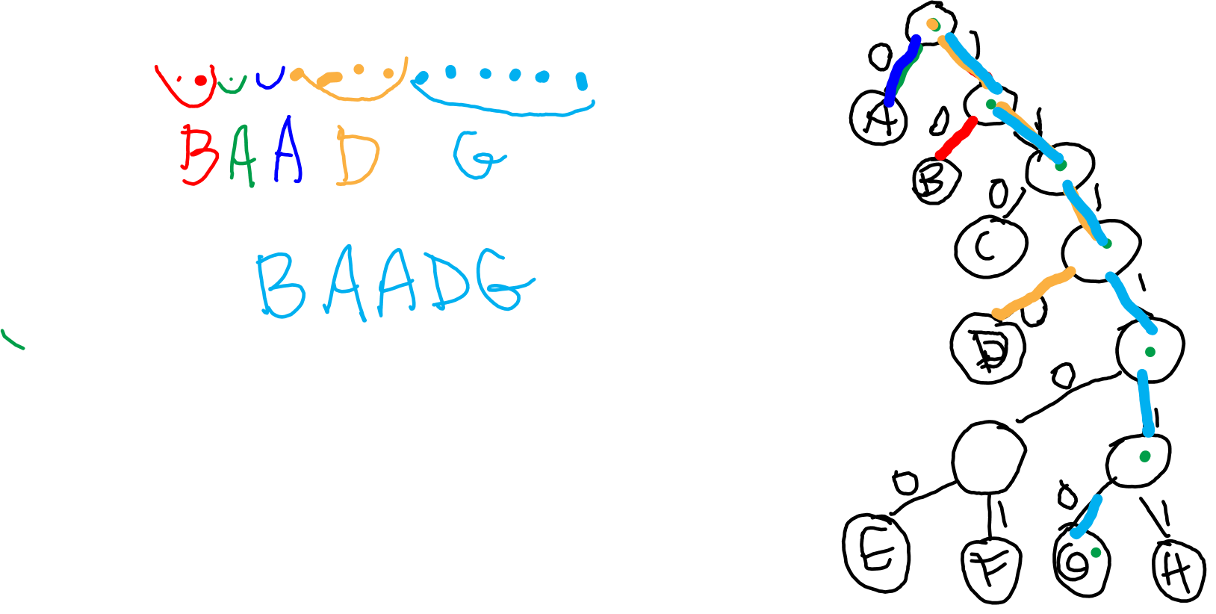
Prefix Code Representation Example
A: 0 1 0 0 0 1 1 1 0 1 1 1 1 1 0
B: 10
C: 110
D: 1110
E: 111100
F: 111101
G: 111110
H: 111111

